Slide 1

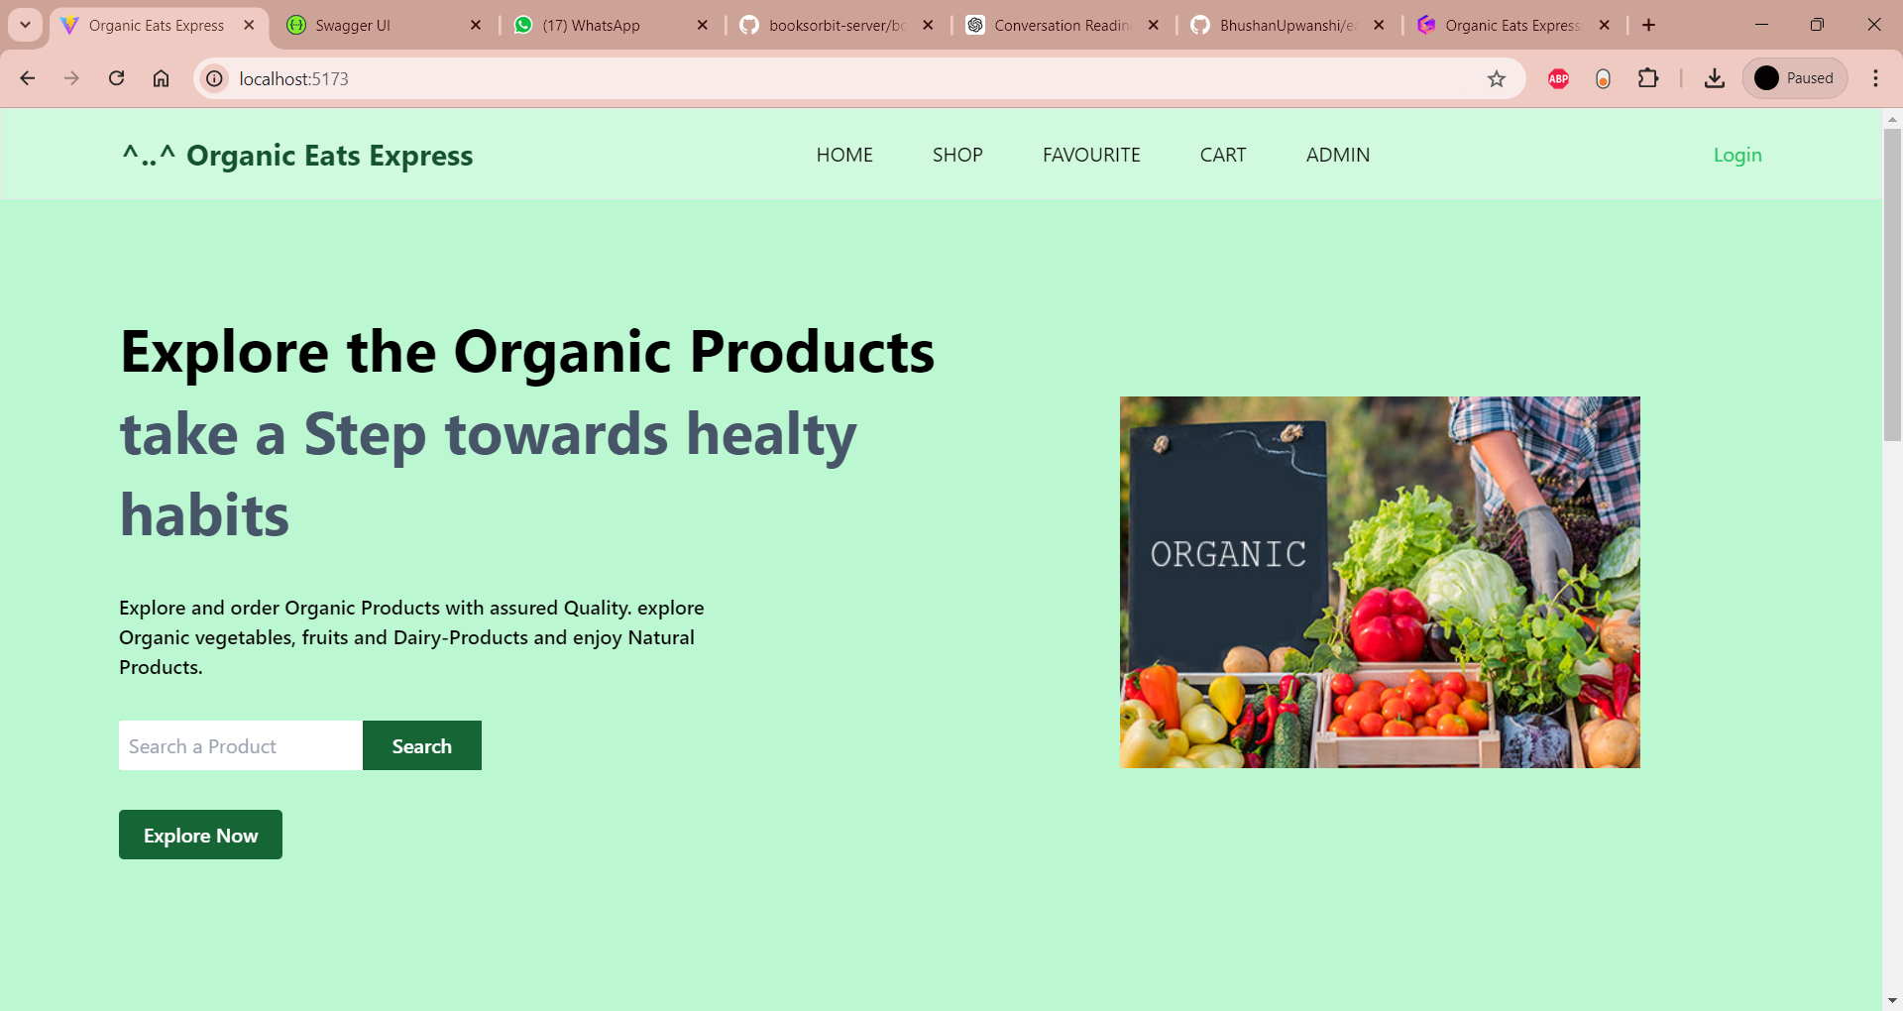
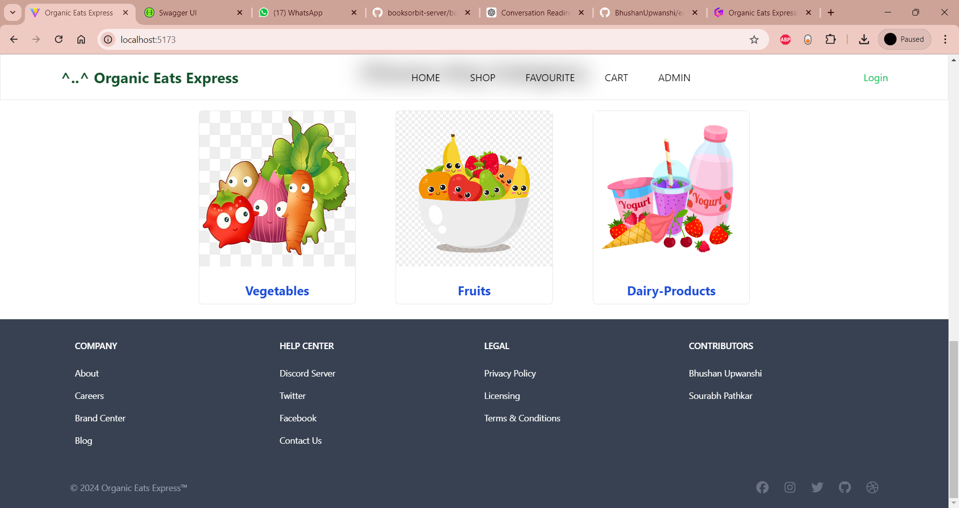
Organic Eats Express: A Healthy Eating Solution
Organic Eats Express is an innovative online platform that provides customers with seamless access to a wide range of organic and healthy food options, revolutionizing the way people approach their daily nutrition.
BS
by : Bhushan Upwanshi (243136) Sourabh Patkar (243212)

Slide 2
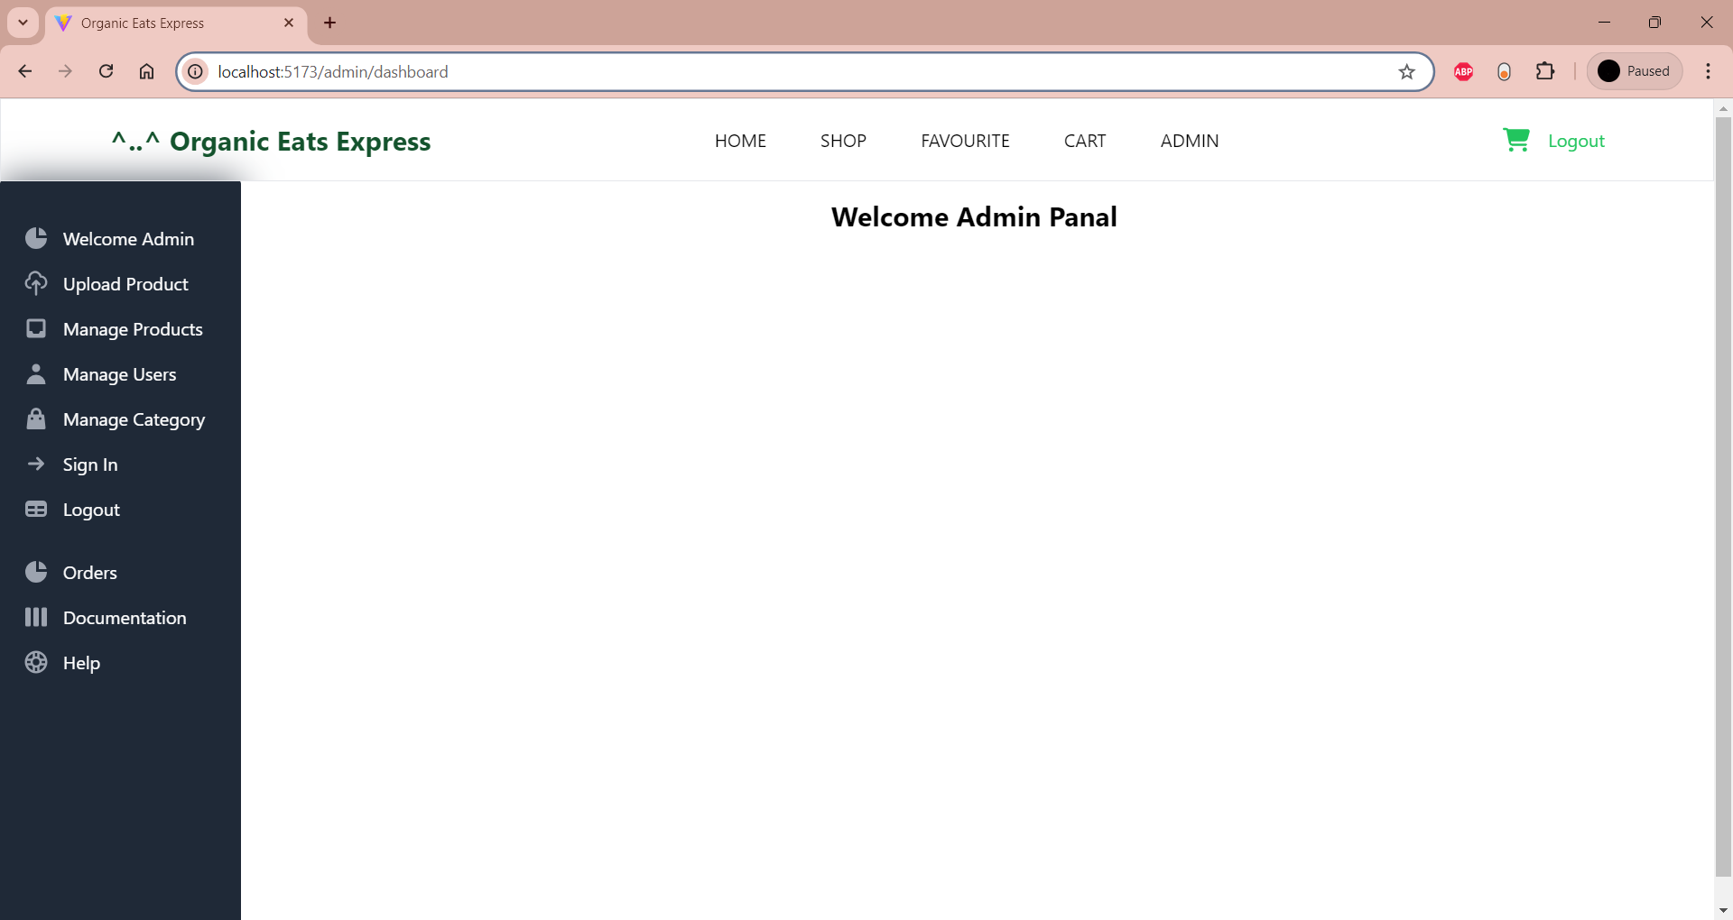
Indexes
Objective
Architecture : cutting edge technology
Customer Centric Features
UML Diagrams
UI Snapshots
Future Expansion
Conclusion

Slide 3
Objective: Delivering Healthy Convenience
Seamless Online Access
Diverse Product Selection
Convenient Management
Organic Eats Express offers customers a user-friendly platform to browse, select, and order a variety of organic and nutritious food options from the comfort of their homes.
The platform features a carefully curated collection of organic produce, whole grains, plant-based proteins, and other health-conscious items to cater to diverse dietary needs.
Organic Eats Express ensures a hassle-free Managing experience, allowing Admins to manage their Product and Customers directly with UI, saving time and effort.

Slide 4




Cutting-Edge Technology
1
Front-End: React.js
2
Back-End: Java Spring Boot
3
Database: MySQL
Organic Eats Express leverages the power of React.js, a renowned JavaScript library, to create a dynamic and responsive user interface that delivers an exceptional customer experience.
The platform's robust back-end is built on Java Spring Boot, a popular and reliable framework that ensures secure and efficient data handling and processing.
Organic Eats Express utilizes the MySQL database management system to store and manage customer information, product data, and order details with high reliability and scalability.

Slide 5

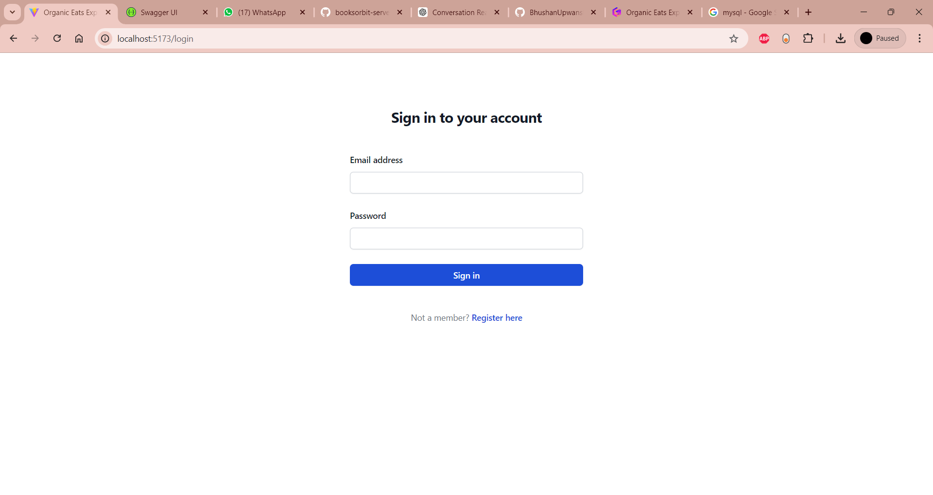
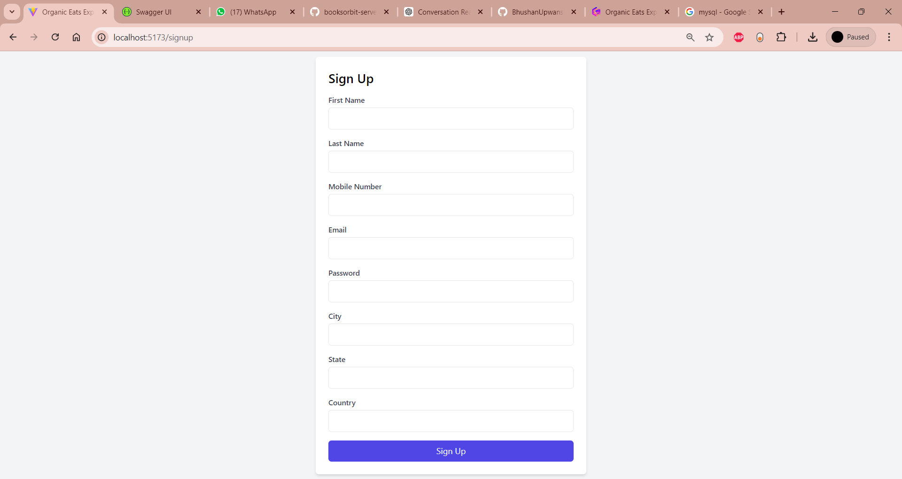
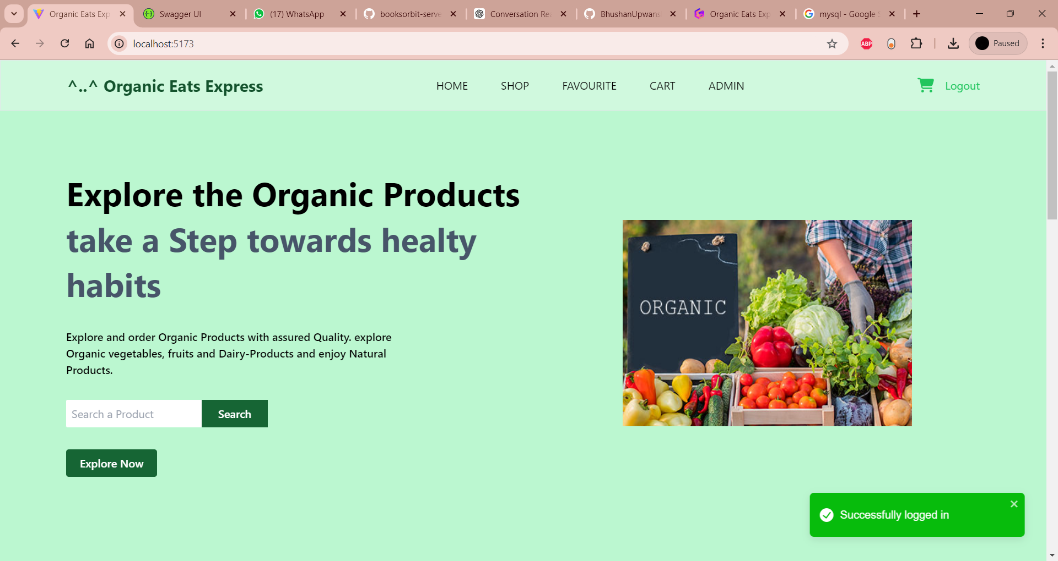
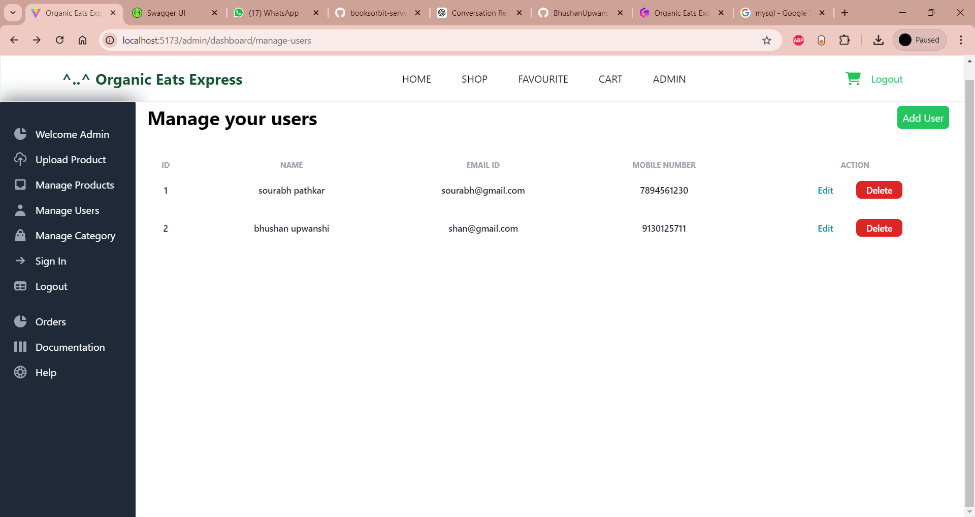
Customer-Centric Features
Seamless Sign-Up and Login
Product Browsing and Ordering
Customers can easily create an account and securely log in to the platform, allowing them to access their personalized shopping experience.
Customers can browse the diverse selection of organic products, add items to their cart, and conveniently place orders through the user-friendly interface.
Admin Management
The platform's admin dashboard enables the management of products, categories, customer accounts, and order fulfillment, ensuring smooth operations.

Slide 6
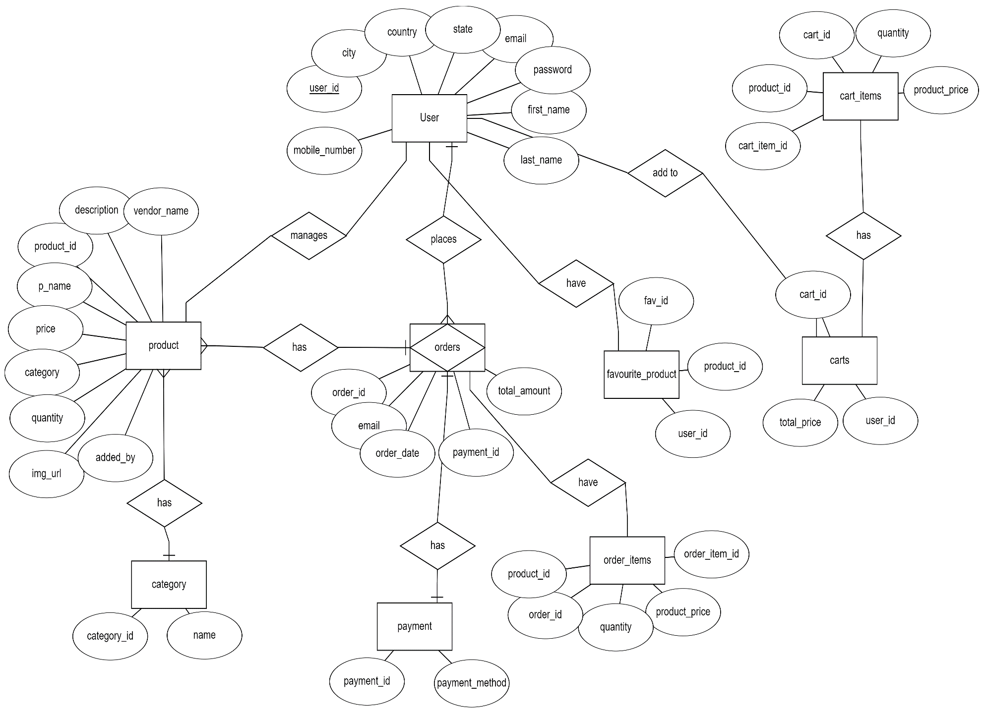
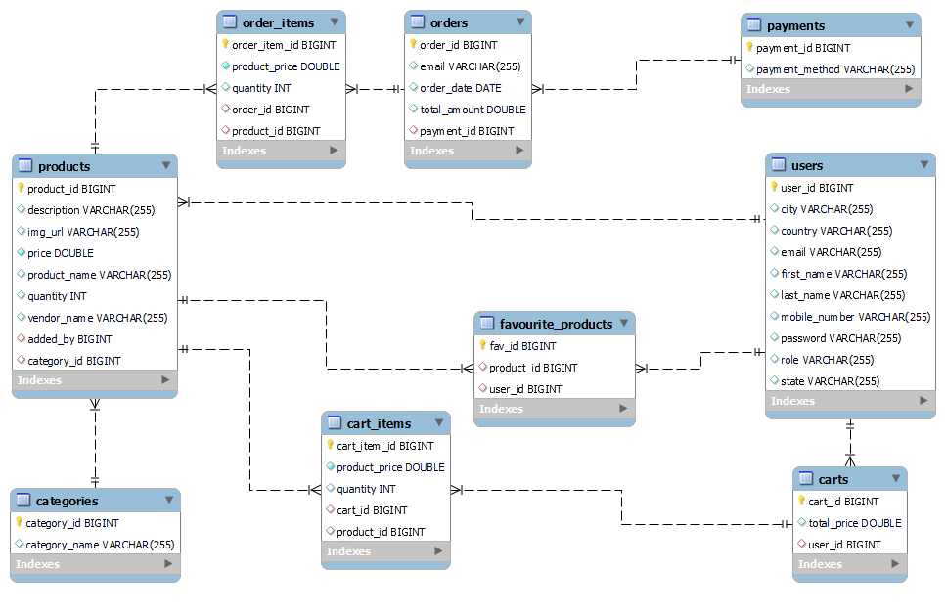
Entity Relationship Diagram

Slide 7
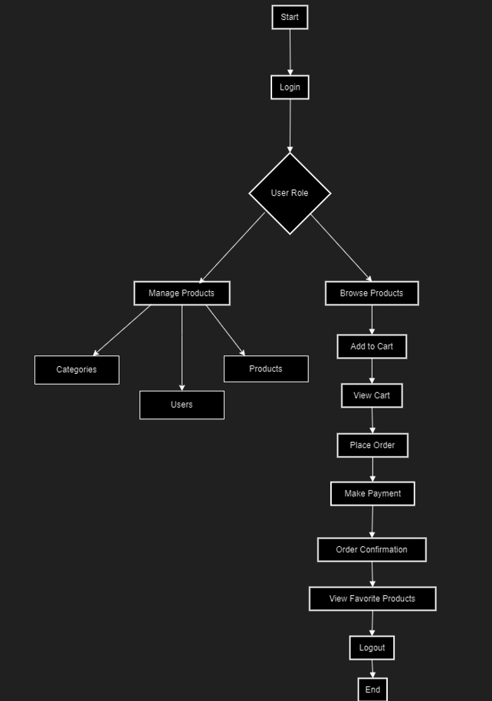
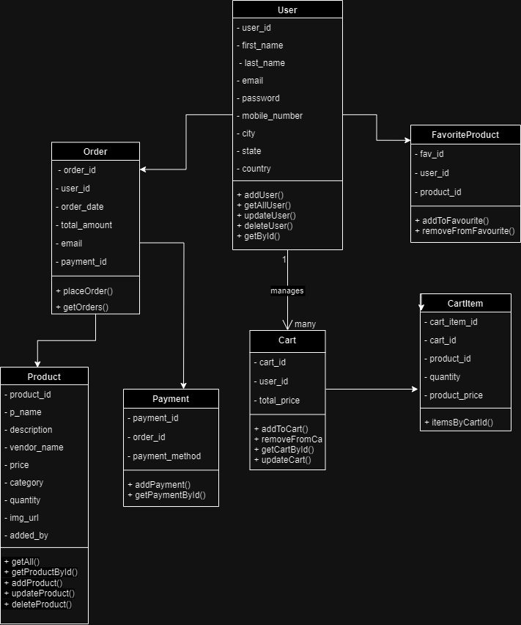
User Activity Diagram
Class Diagram

Slide 8
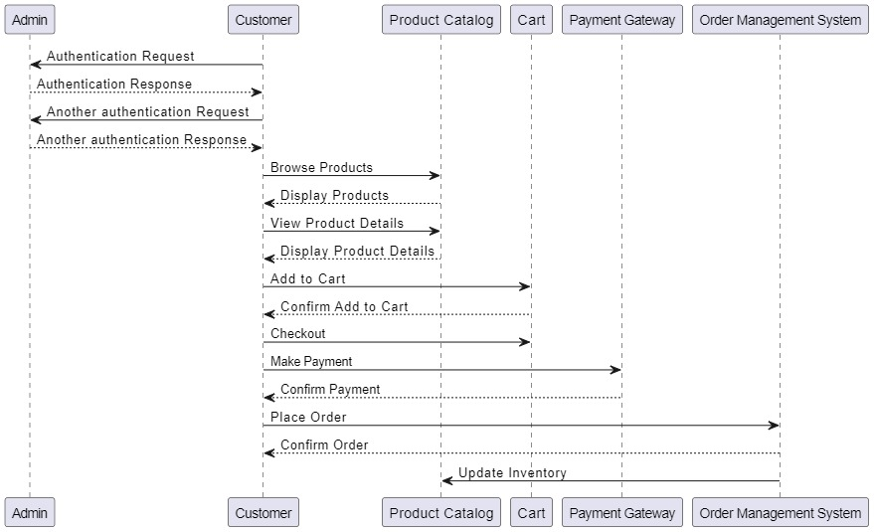
Sequence Diagram

Slide 9
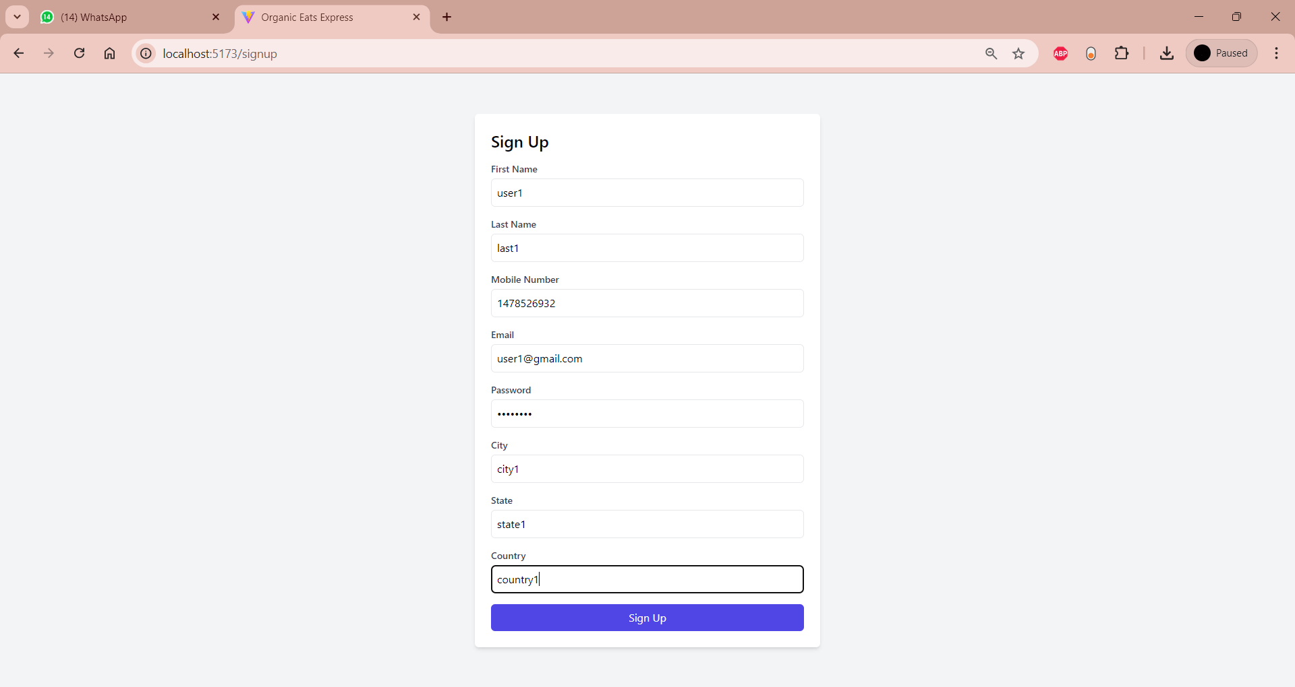
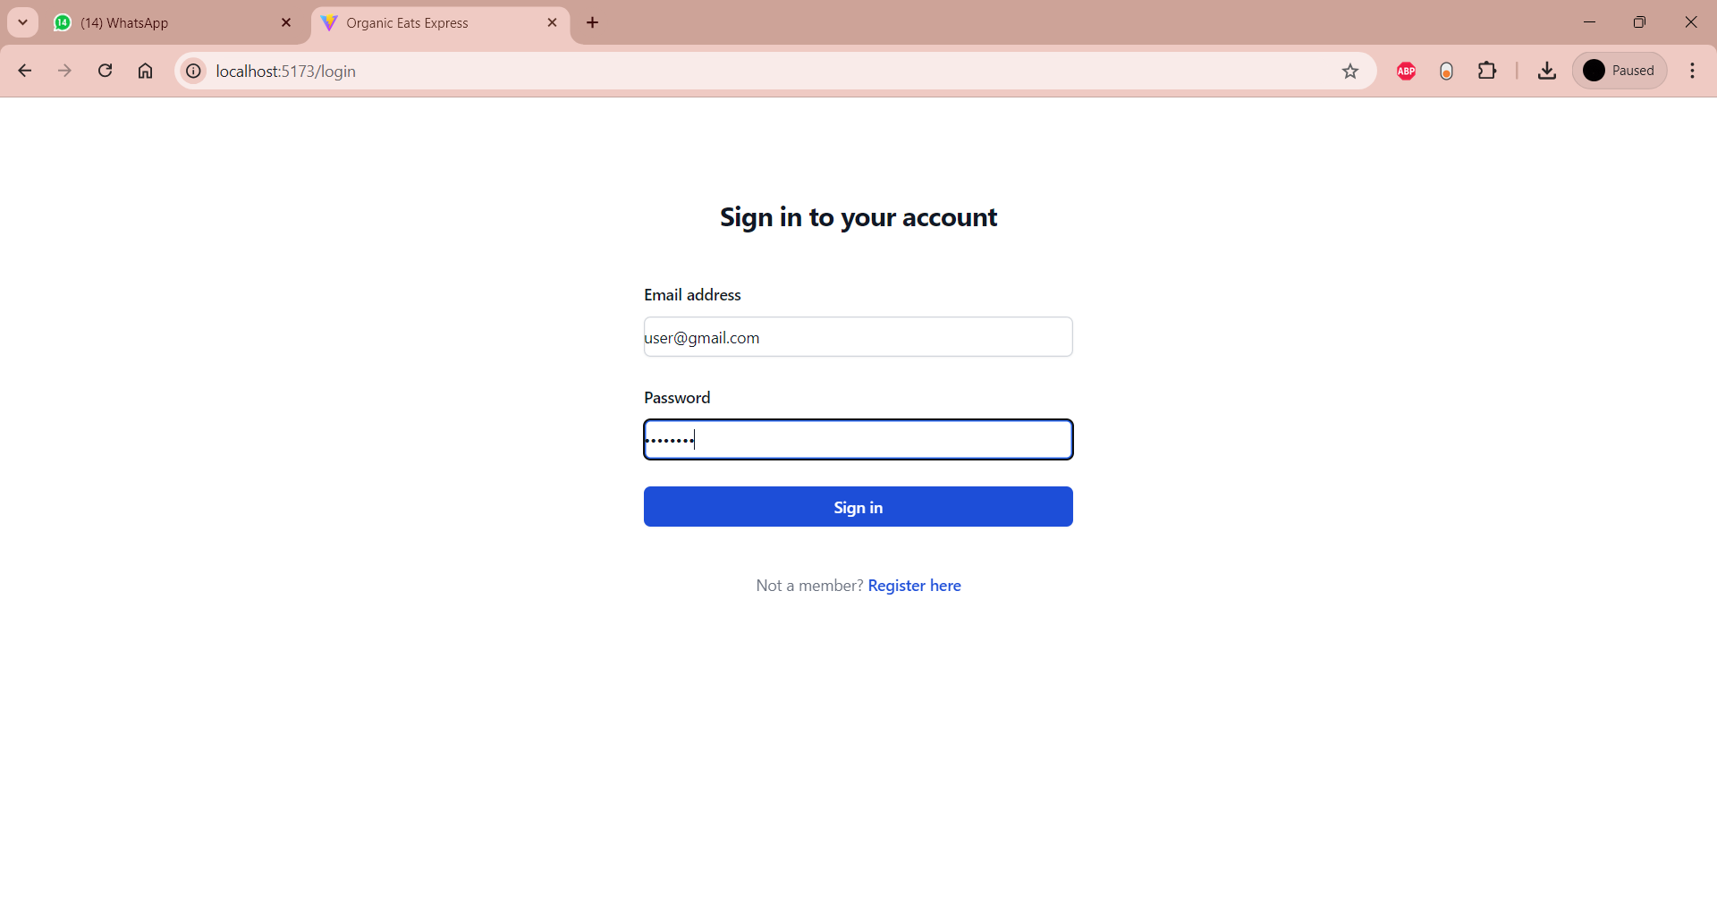
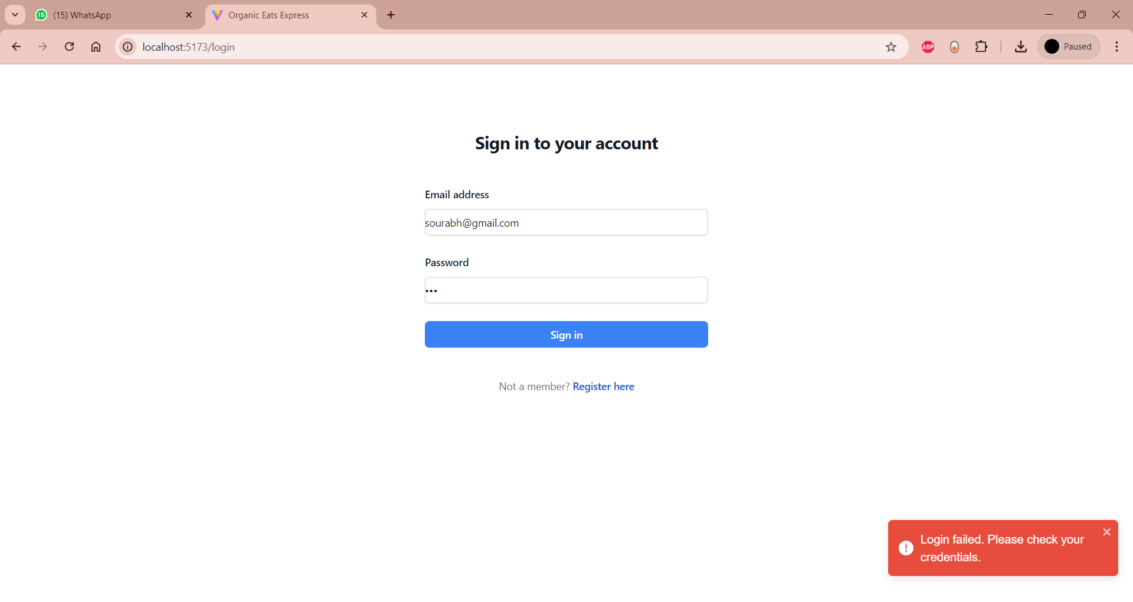
User Interface

Slide 10
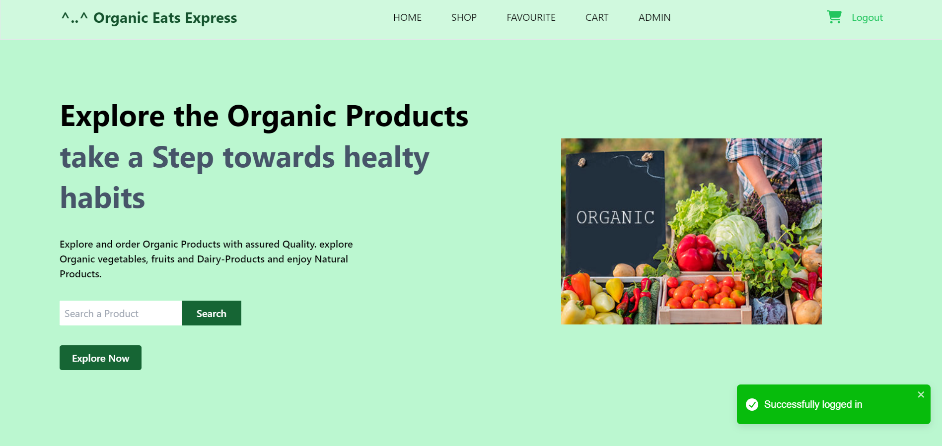
HomePage

Slide 11
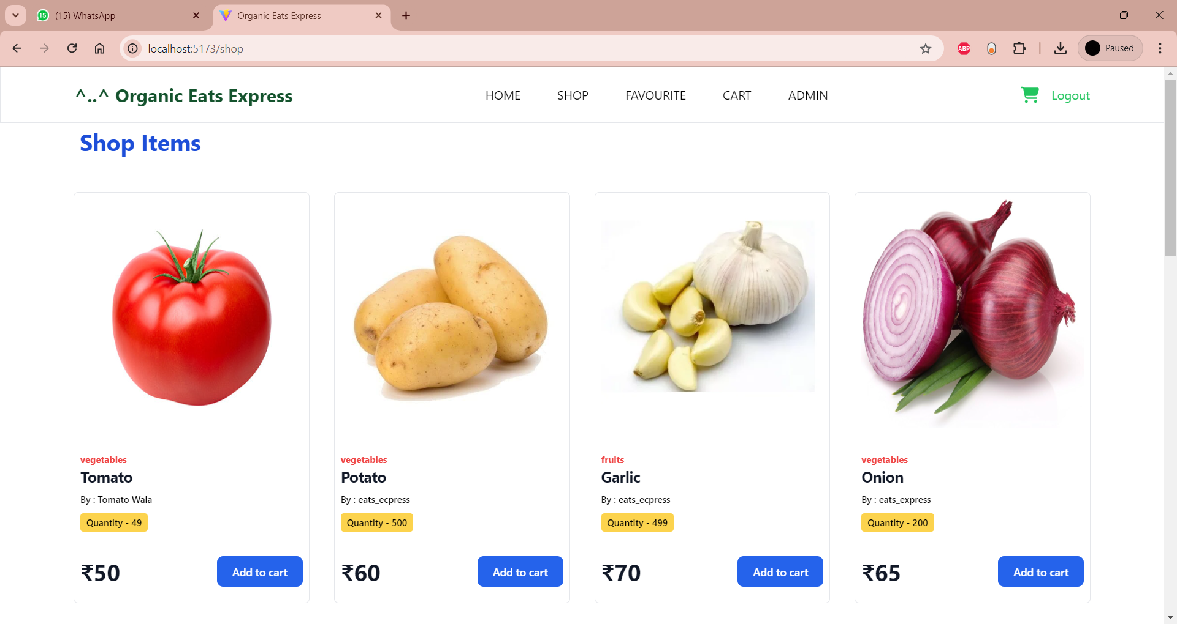
Products Page

Slide 12
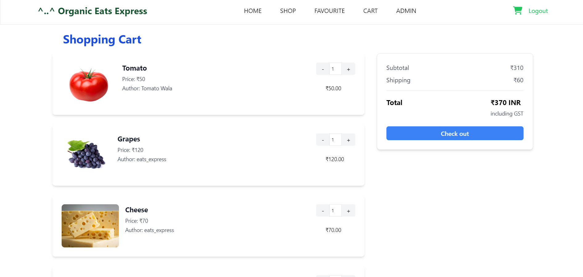
Cart and Billing

Slide 13
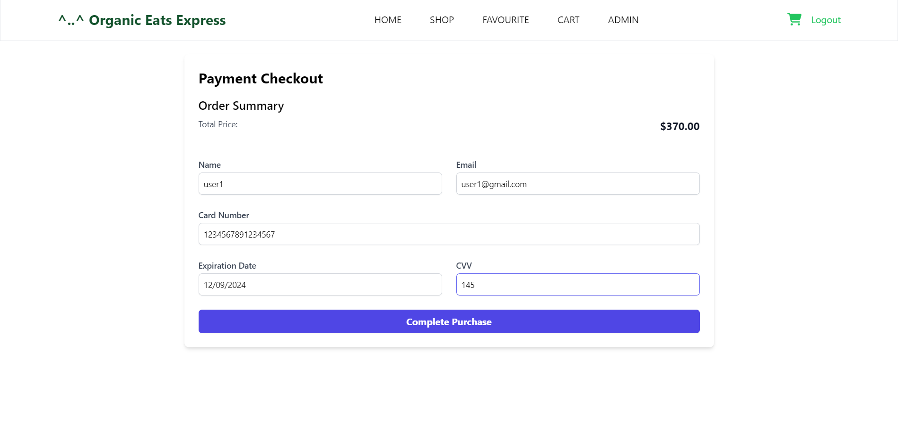
Payment Page

Slide 14

Order Successful Notification

Slide 15
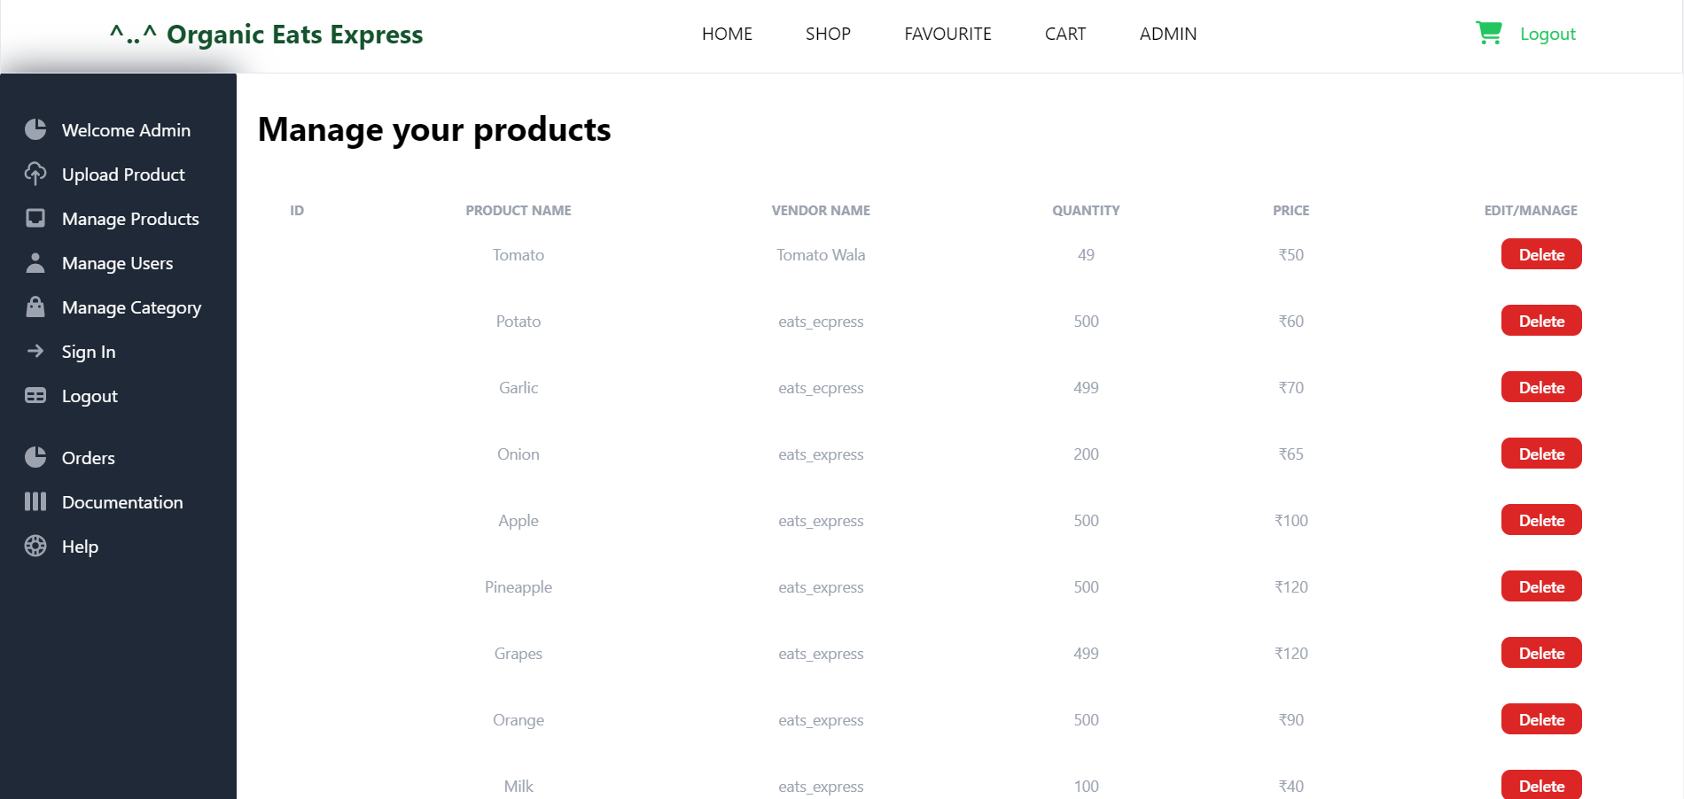
Admin UI

Slide 16
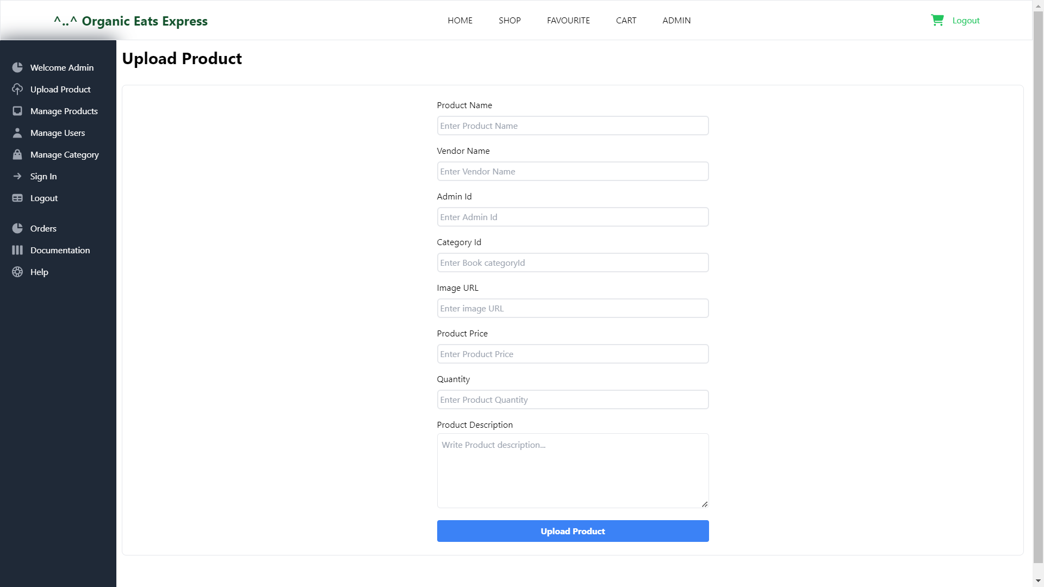

Slide 17
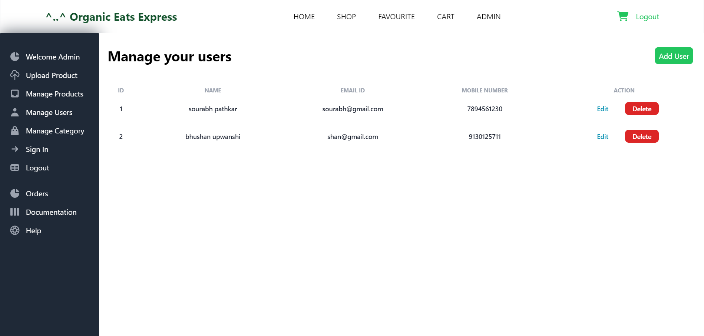

Slide 18
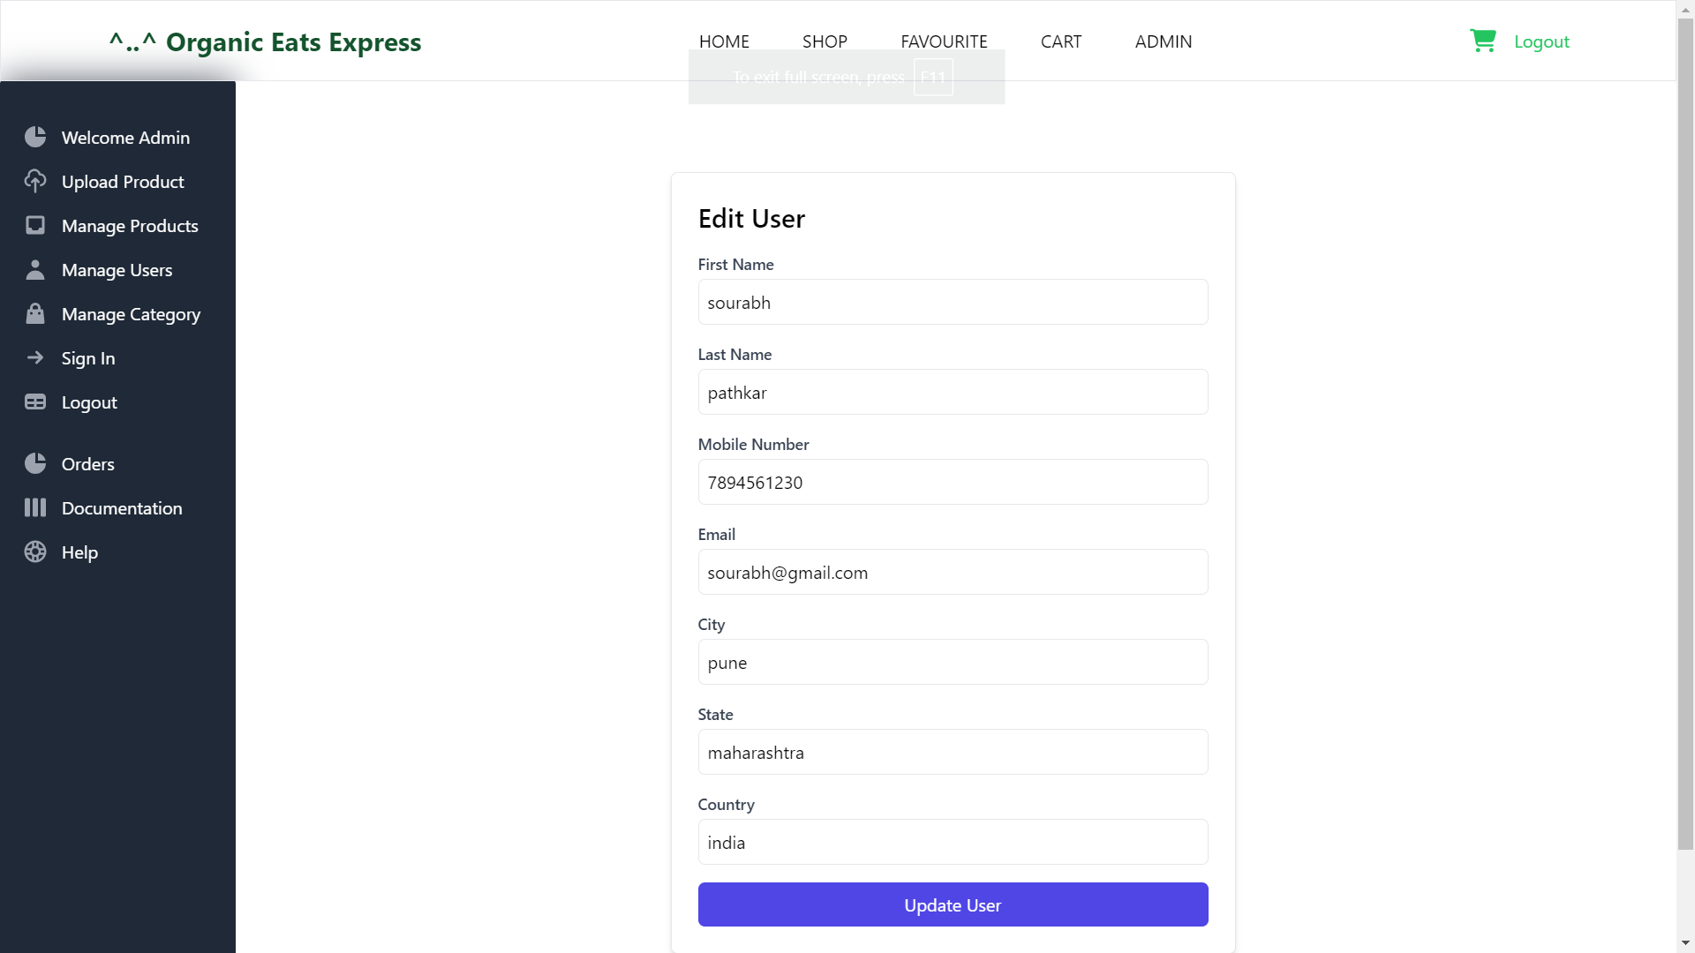

Slide 19
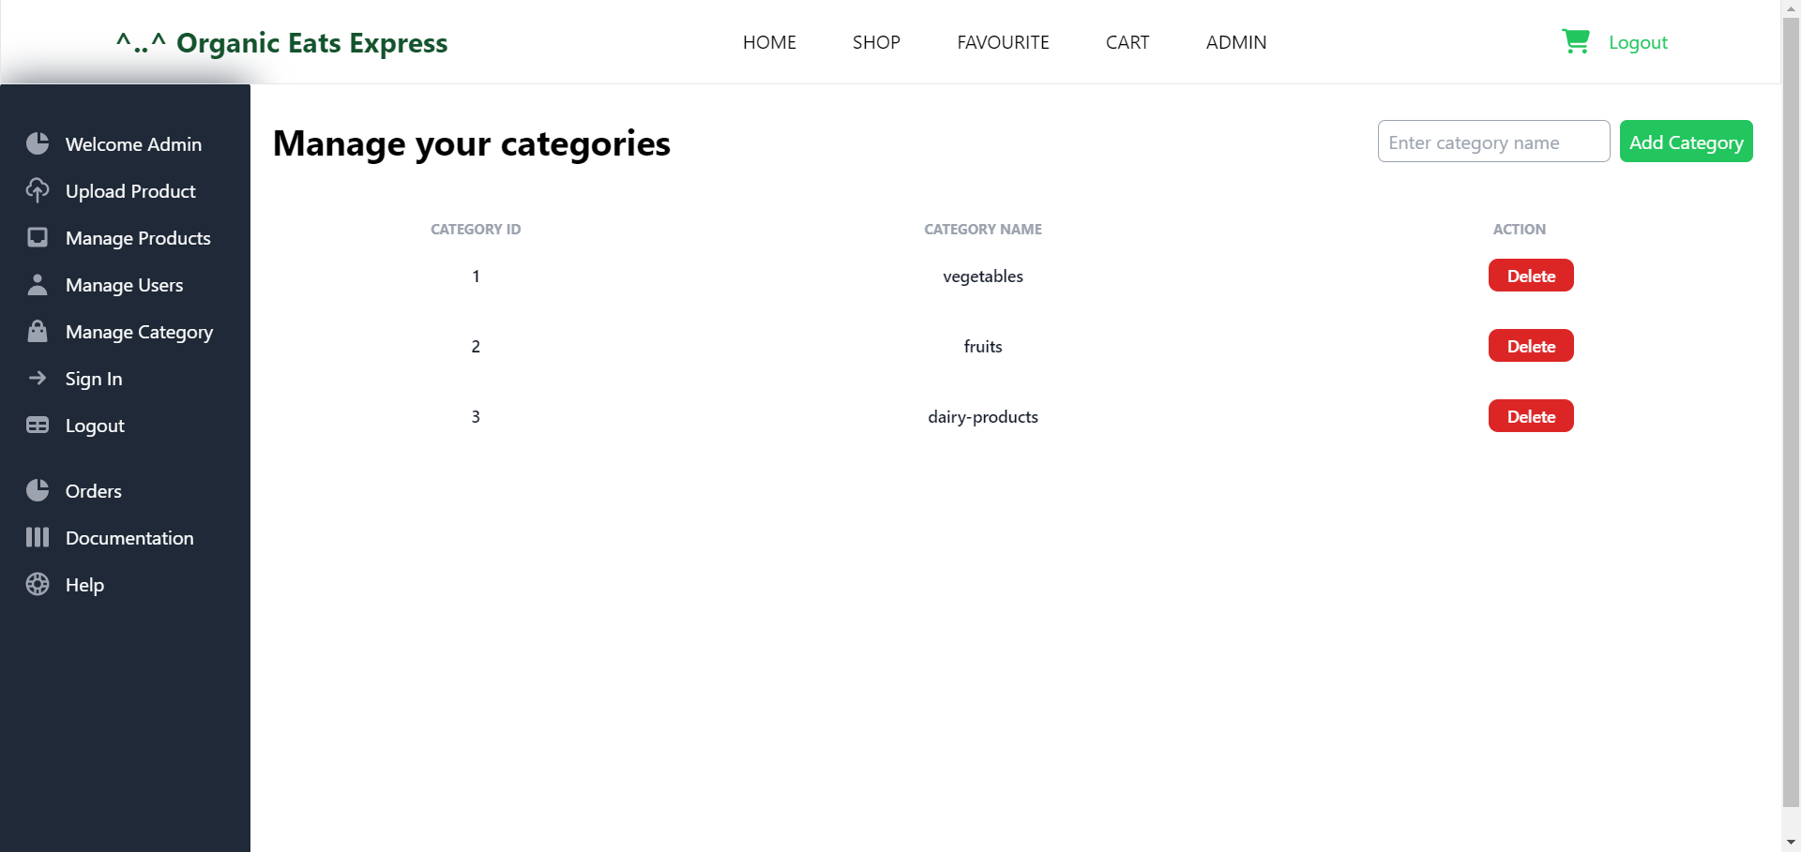

Slide 20
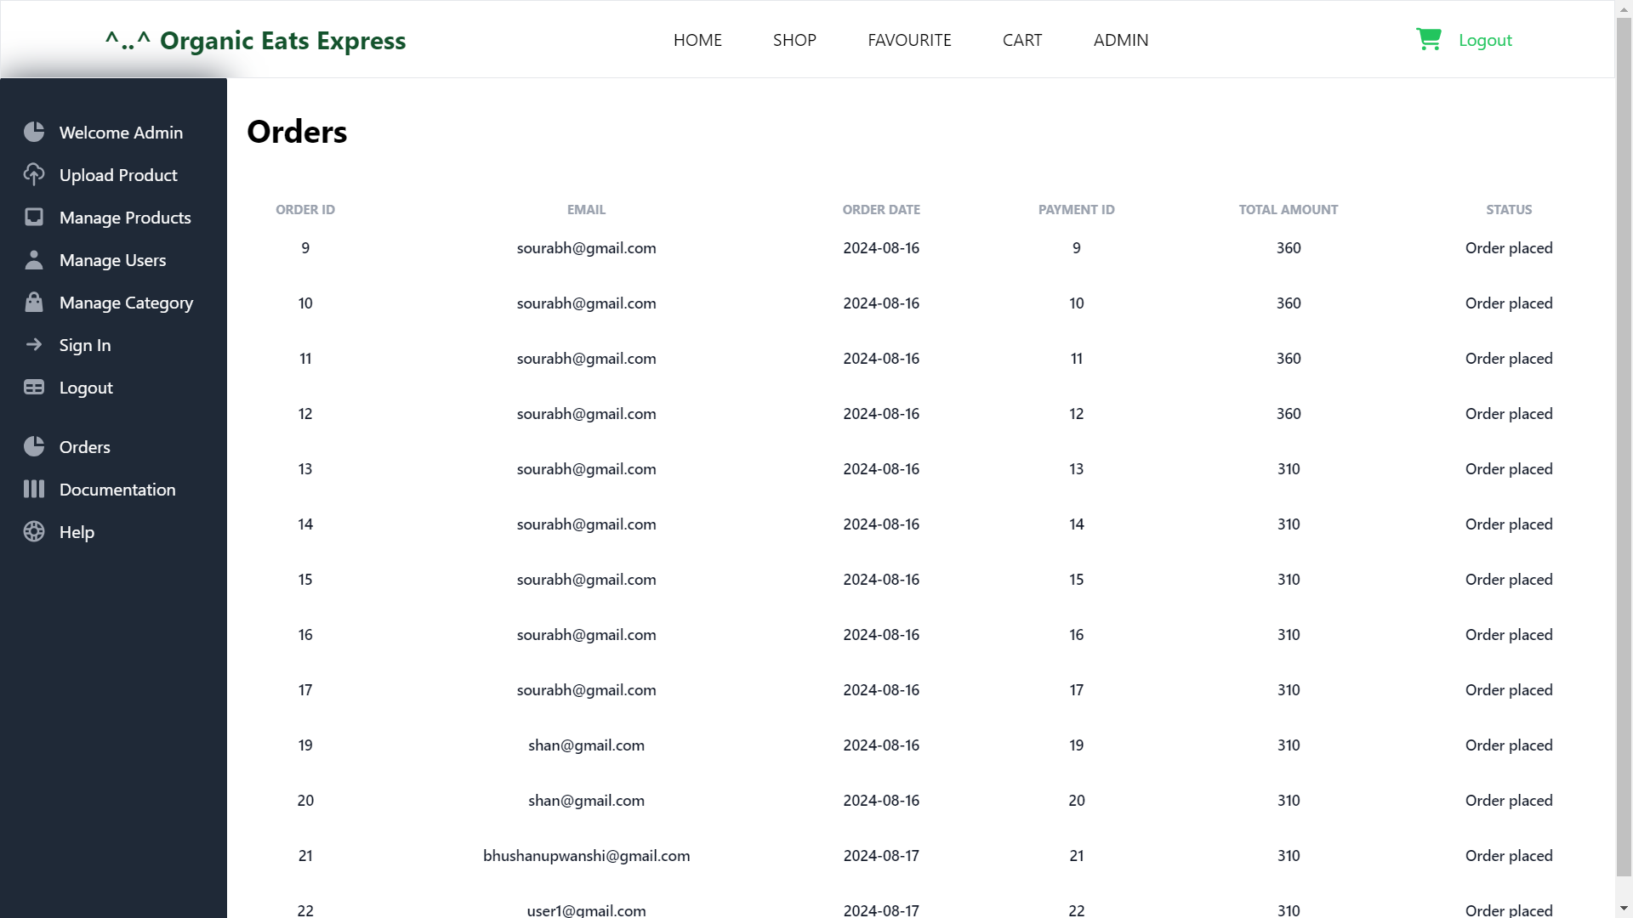

Slide 21




Future Expansion
Payment Gateway Integration
Delivery Management
Organic Eats Express plans to integrate a secure payment gateway, allowing customers to seamlessly complete their transactions and enjoy a comprehensive online shopping experience.
The platform aims to enhance its delivery capabilities, leveraging advanced logistics and partnerships to ensure timely and reliable transportation of organic products to customers' doorsteps.

Slide 22


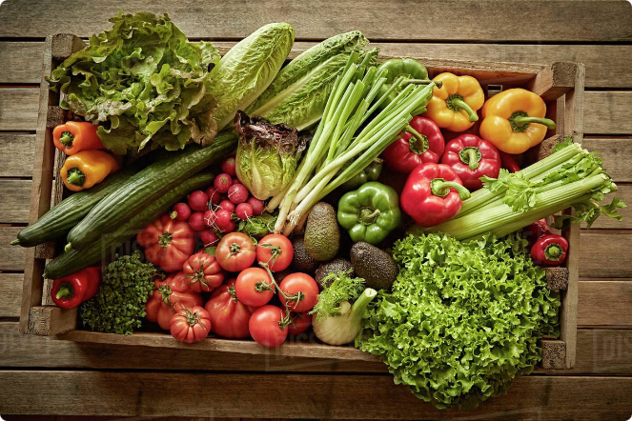


Revolutionizing Healthy Eating
Organic Goodness
Organic Eats Express is committed to sourcing the finest organic produce, minimizing the use of harmful chemicals and preservatives to provide customers with the healthiest options.
Nutrition-Focused
The platform's product selection is carefully curated to cater to diverse dietary needs, promoting a well-balanced and nutrient-rich lifestyle for its customers.
Convenient Experience
Organic Eats Express aims to simplify the healthy eating journey, offering a seamless online platform that brings organic goodness straight to customers' doorsteps.

Slide 23


Conclusion: Organic Eats Express - Revolutionizing Healthy Eating Habits
Summary :
“Organic Eats Express” provides a robust platform for managing organic product sales.
The project effectively combines customer and admin functionalities into a seamless experience.
Thank You

